Slide 1
SharkSpace Navigator
Sharks from Space challenge
Wolfram Institute https://luke-wriglesworth.github.io/wolfram-nasa-hackathon-2025/

Slide 2
Introduction
For the Sharks from Space challenge, we created an interactive visualization tool that integrates real NASA datasets such as ocean current, mesoscale eddies, and temperature to highlight potential shark foraging zones.
With this project we ensure all scientific data and references come directly from verified NASA sources. This approach ensures that our project is scientifically accurate, transparent, and reproducible, while showcasing how technology and open data can support ocean conservation.

Slide 3
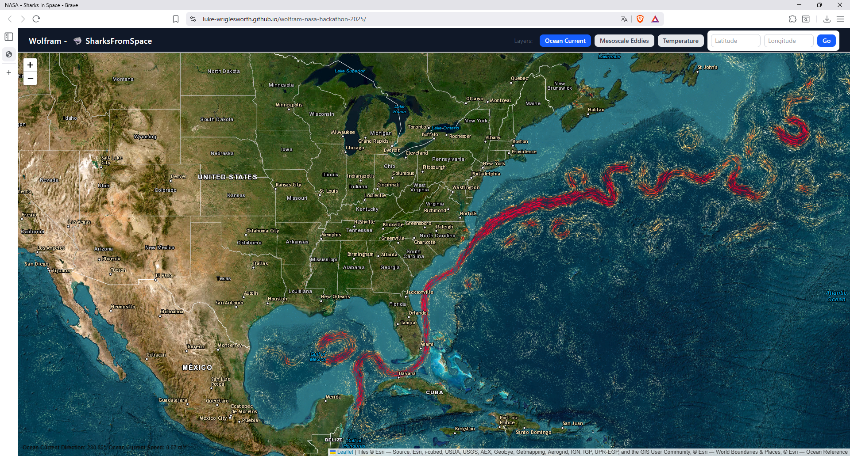
Ocean Current View
transport nutrients and prey, creating feeding grounds that attract sharks
Interactive menu
Specific search

Slide 4
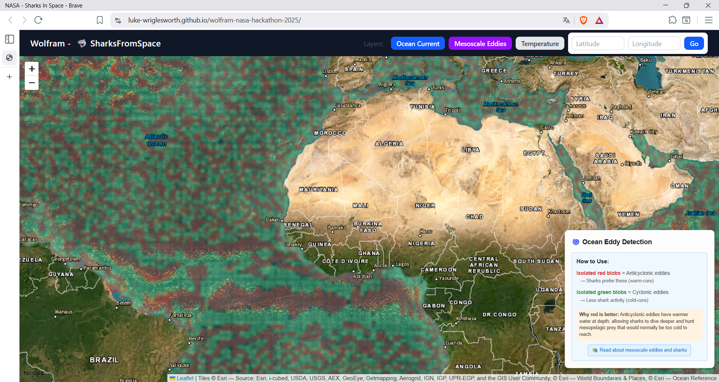
Mesoscale Eddies View
(large rotating water masses) trap nutrients and fish, forming biological “hotspots” where sharks often forage. These ranging from 10 to 500 kilometers in diameter that last from days to months.
Explanation
References

Slide 5
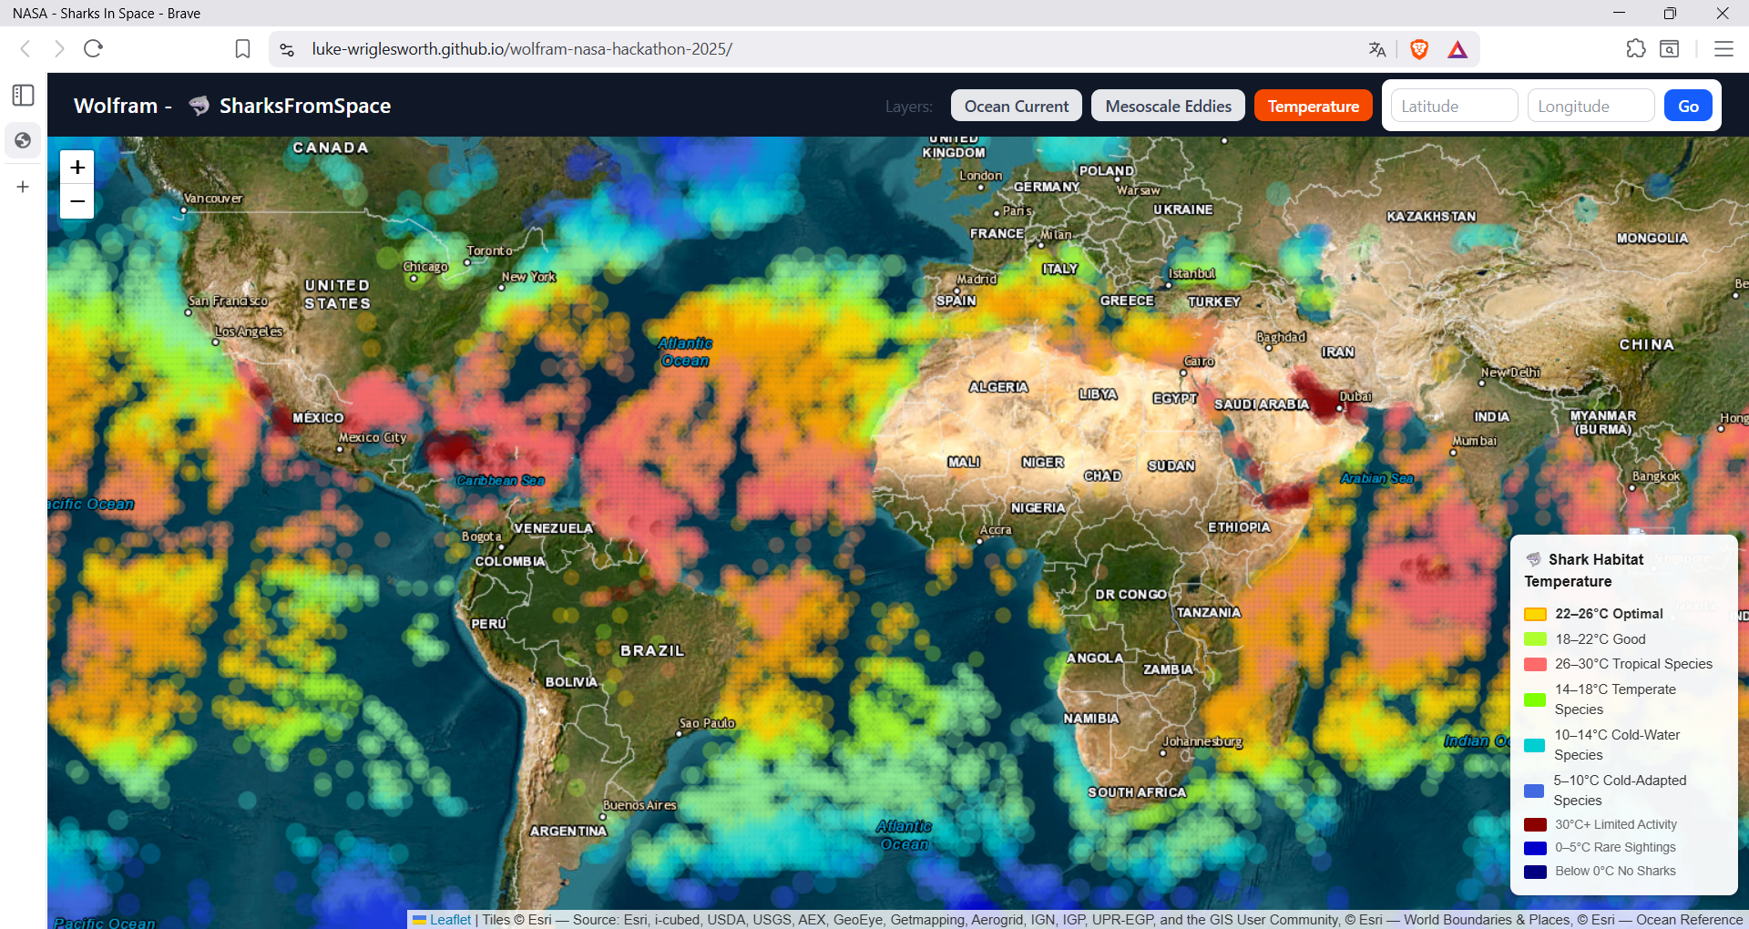
Temperature View
influences shark distribution since most species prefer specific thermal ranges for metabolism and hunting.
Heat map

